Slide 1
Transmission
Control Protocol
(TCP)

Slide 2
CONTENTS
PROCESS-TO-PROCESS COMMUNICATION
TCP SERVICES
NUMBERING BYTES
FLOW CONTROL
SILLY WINDOW SYNDROME
ERROR CONTROL

Slide 3
CONTENTS (continued)
CONGESTION CONTROL
SEGMENT
OPTIONS
CHECKSUM
CONNECTION
STATE TRANSITION DIAGRAM
TCP OPERATION
TCP PACKAGE

Slide 4
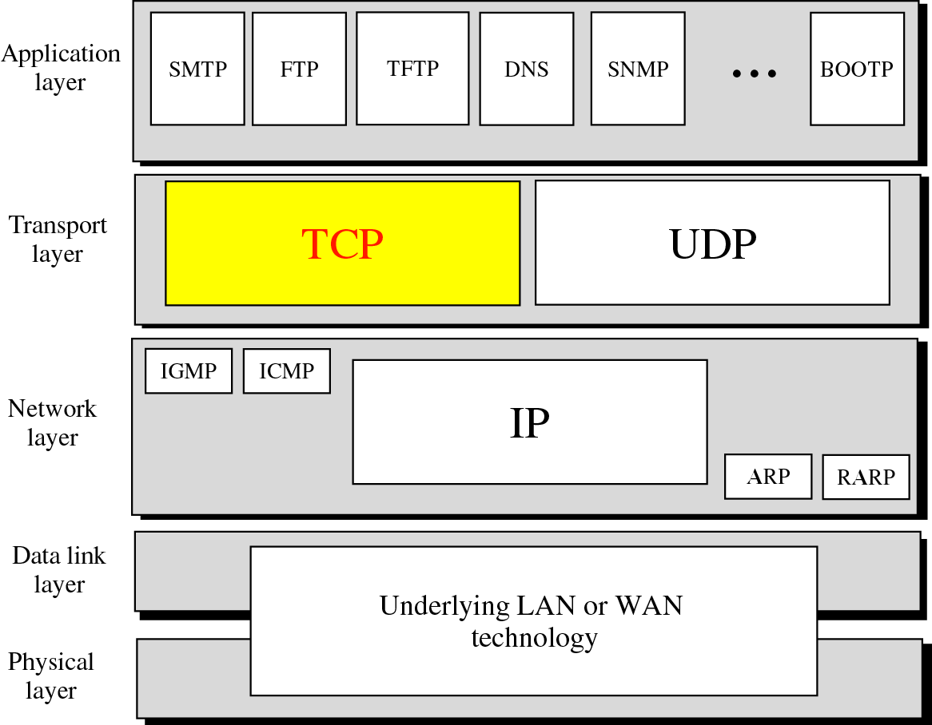
Position of TCP in TCP/IP protocol suite

Slide 5
PROCESS
TO
PROCESS
COMMUNICATION

Slide 6
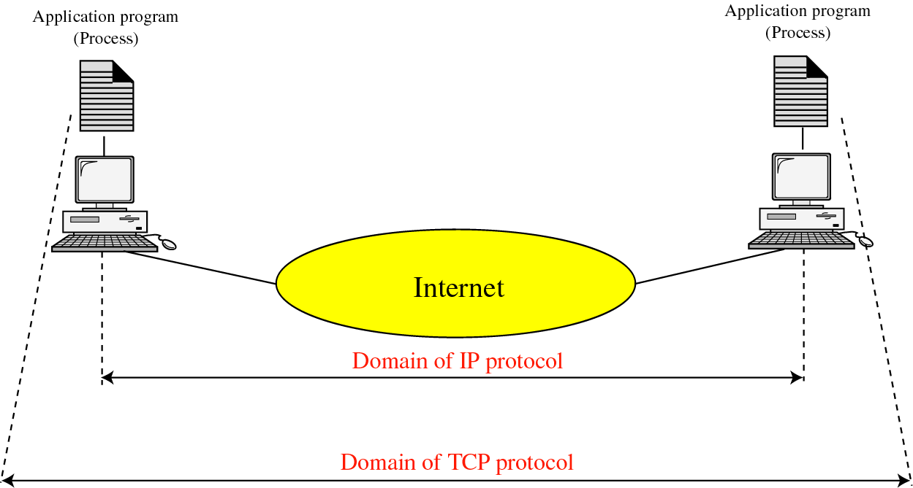
TCP versus IP

Slide 7
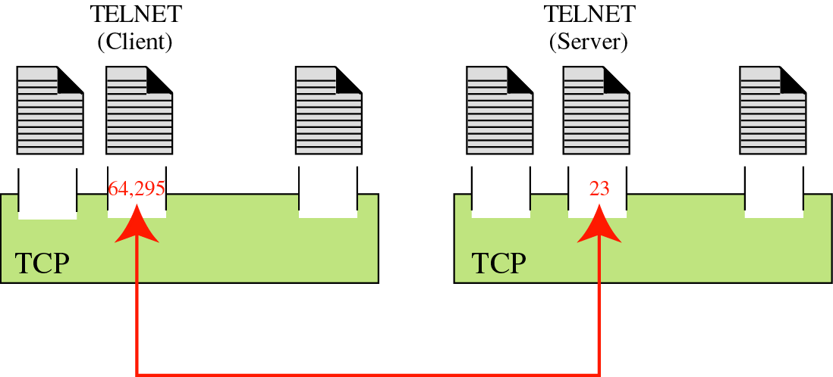
Port numbers

Slide 8
TCP
SERVICES

Slide 9
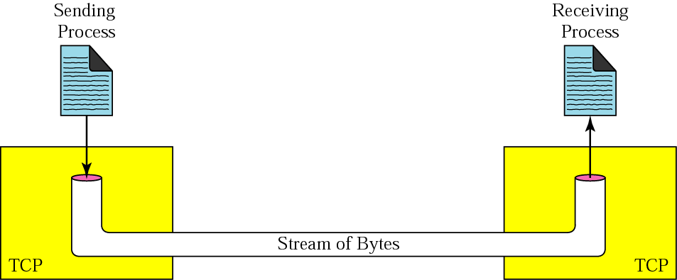
Stream delivery

Slide 10
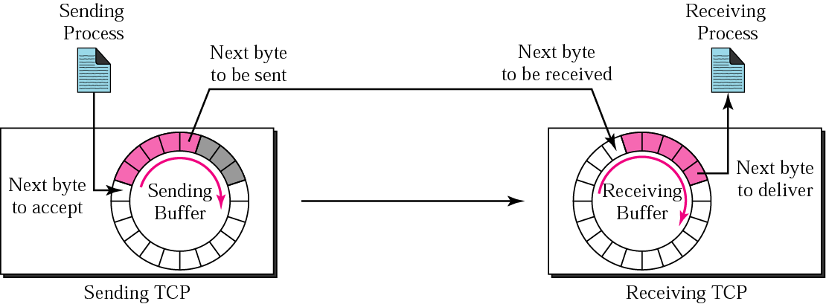
Sending and receiving buffers

Slide 11
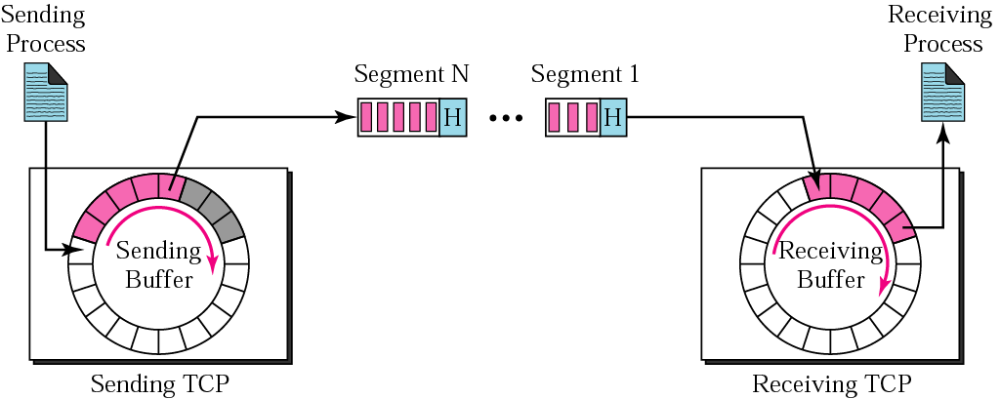
TCP segments

Slide 12
NUMBERING
BYTES

Slide 13

The bytes of data being transferred in each connection are numbered by TCP. The numbering starts with a randomly generated number.

Slide 14
Example 1
Imagine a TCP connection is transferring
a file of 6000 bytes. The first byte is
numbered 10010. What are the sequence
numbers for each
segment if data is sent in five segments
with the first four segments carrying
1,000 bytes and the last
segment carrying 2,000 bytes?

Slide 15
Solution
The following shows the sequence number for each segment:
Segment 1 ➔ 10,010 (10,010 to 11,009)
Segment 2 ➔ 11,010 (11,010 to 12,009)
Segment 3 ➔ 12,010 (12,010 to 13,009)
Segment 4 ➔ 13,010 (13,010 to 14,009)
Segment 5 ➔ 14,010 (14,010 to 16,009)

Slide 16
The value of the sequence number field in a segment defines the number of the first data byte contained in that segment.

Slide 17
The value of the acknowledgment field in a segment defines the number of the next byte a party expects to receive. The acknowledgment number is cumulative.

Slide 18
FLOW
CONTROL

Slide 19
A sliding window is used to make transmission more efficient as well as to control the flow of data so that the destination does not become overwhelmed with data. TCP’s sliding windows are byte oriented.

Slide 20
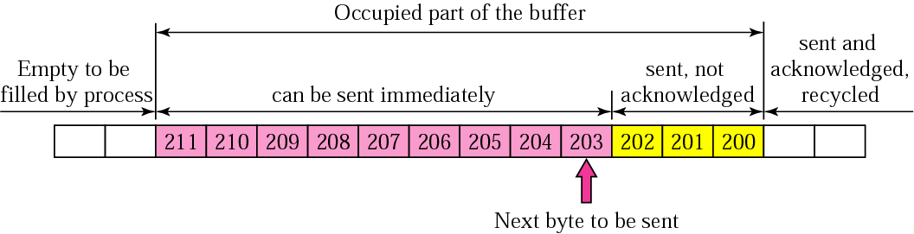
Sender buffer

Slide 21
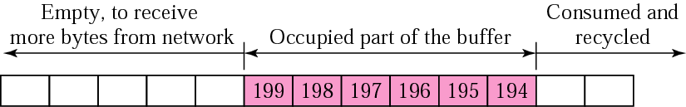
Receiver window

Slide 22
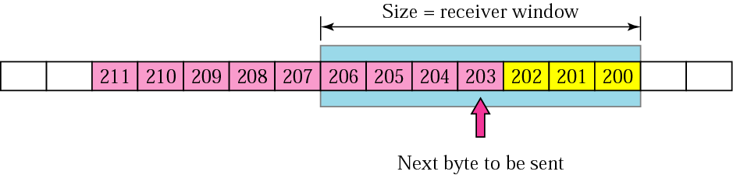
Sender buffer and sender window

Slide 23
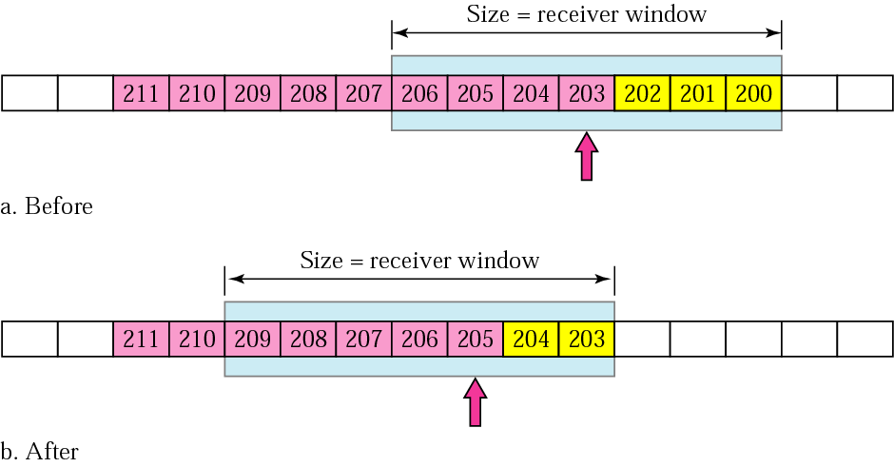
Sliding the sender window

Slide 24
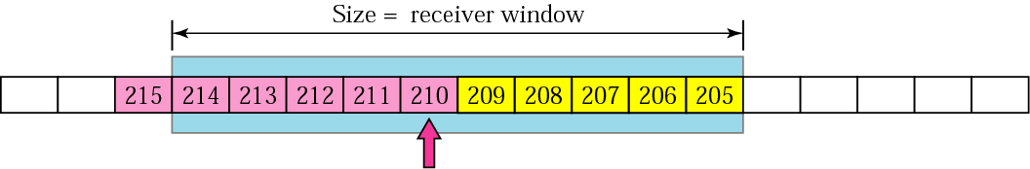
Expanding the sender window

Slide 25
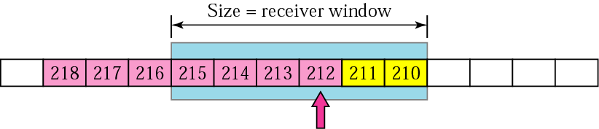
Shrinking the sender window

Slide 26
In TCP, the sender window size is controlled by the receiver window value. However, the actual window size can be smaller if there is congestion in the network.

Slide 27
Some Points about TCP’s Sliding Windows:
1. The source does not have to send a full window’s worth of data.
2. The size of the window can be increased or decreased by the destination.
3. The destination can send an acknowledgment at any time.

Slide 28
SILLY
WINDOW
SYNDROME

Slide 29
ERROR
CONTROL

Slide 30
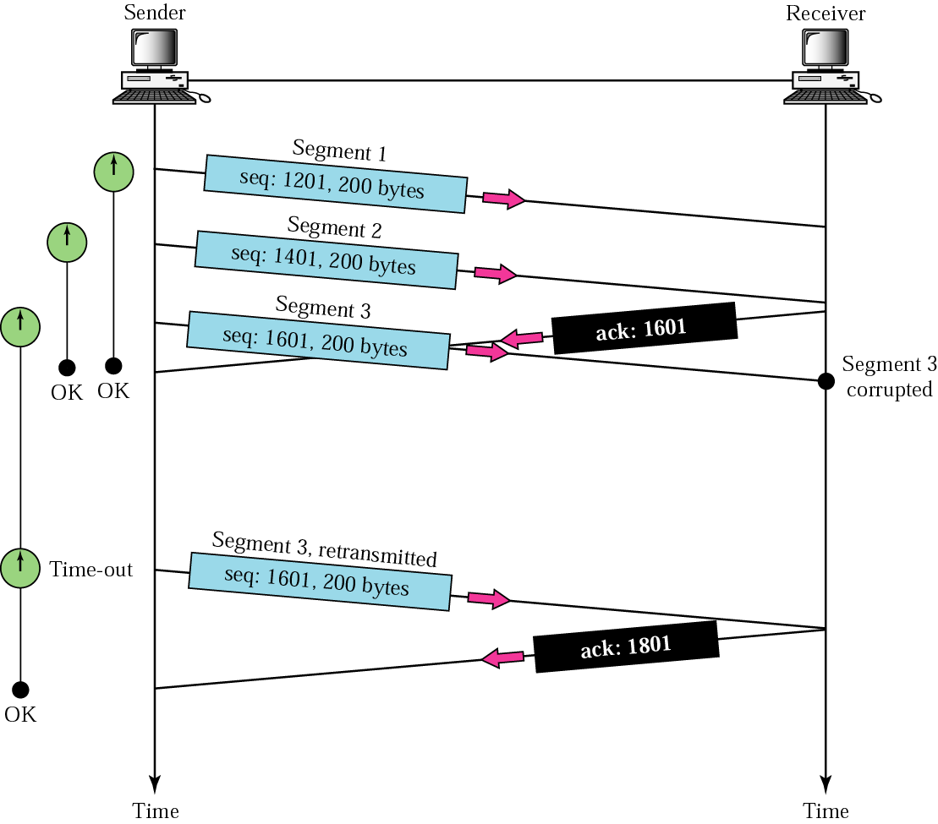
Corrupted segment

Slide 31
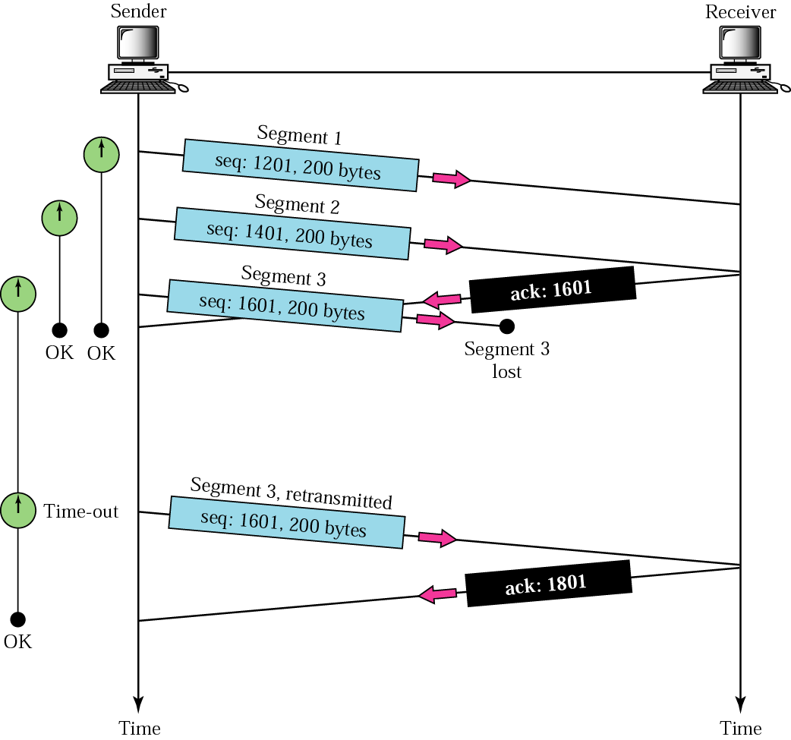
Lost segment

Slide 32
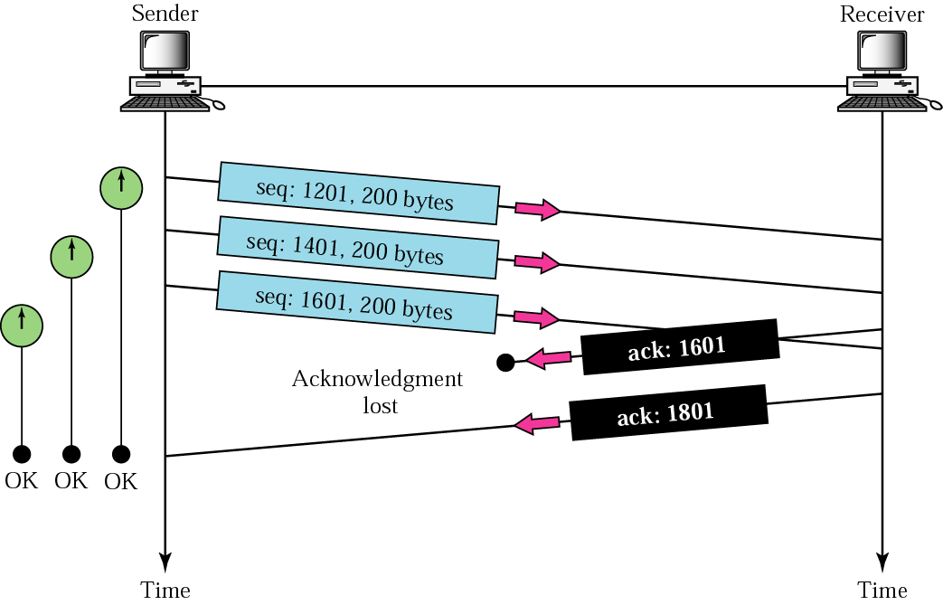
Lost acknowledgment

Slide 33
CONGESTION
CONTROL

Slide 34
TCP assumes that the cause of a lost segment is due to congestion in the network.

Slide 35
If the cause of the lost segment is congestion, retransmission of the segment not only does not remove the cause, it aggravates it.

Slide 36
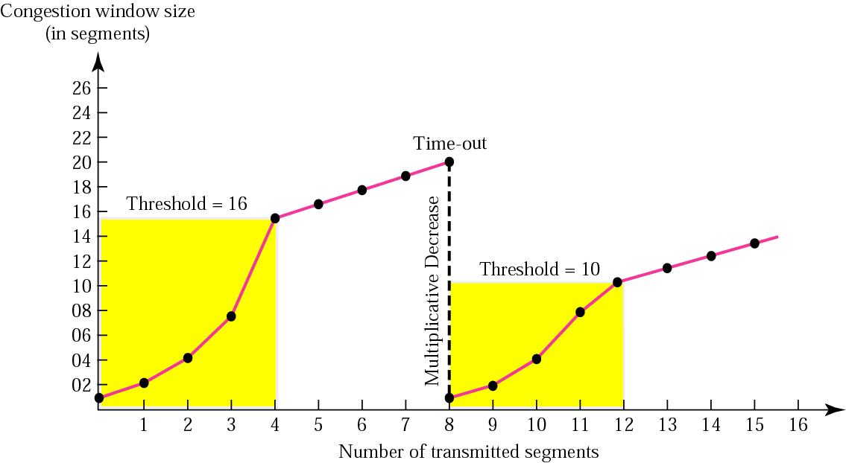
Multiplicative decrease

Slide 37
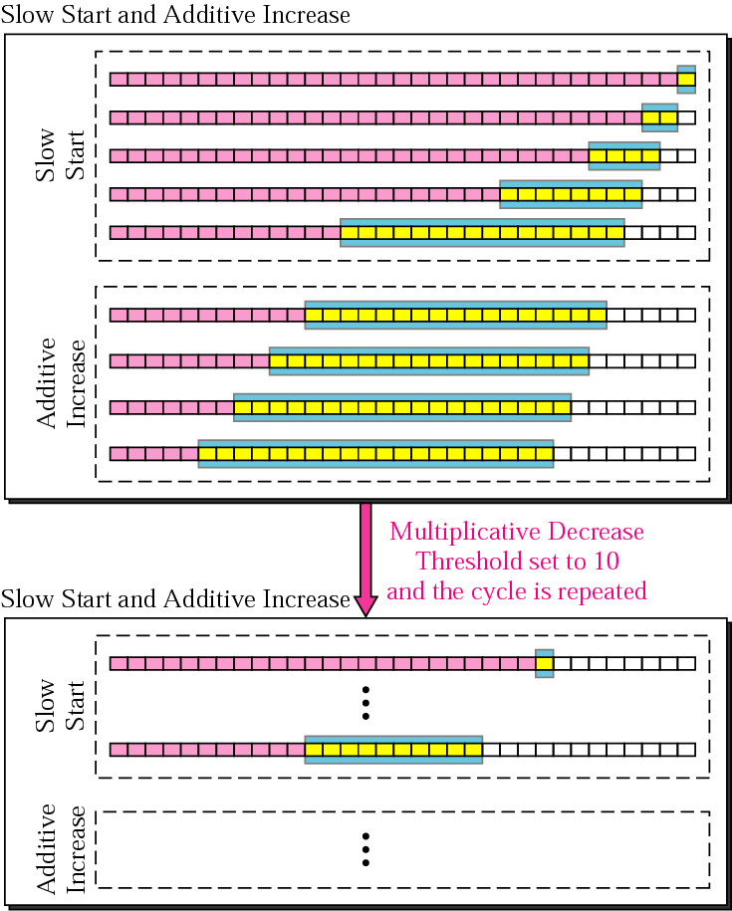
Congestion avoidance strategies

Slide 38
SEGMENT

Slide 39
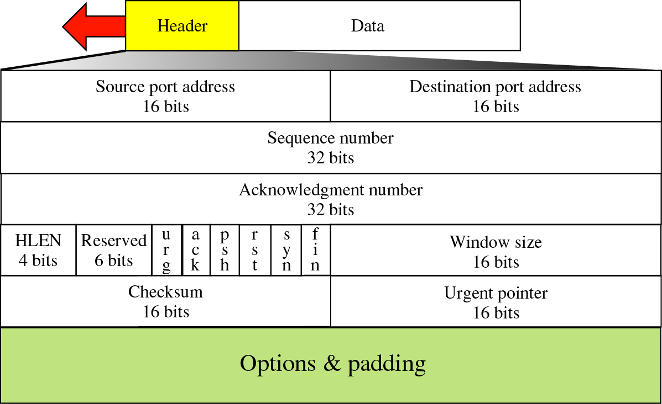
TCP segment format

Slide 40
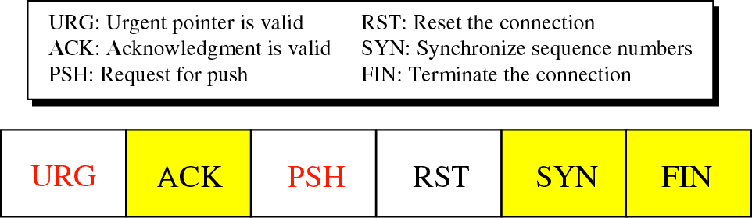
Control field

Slide 41
CONNECTION

Slide 42
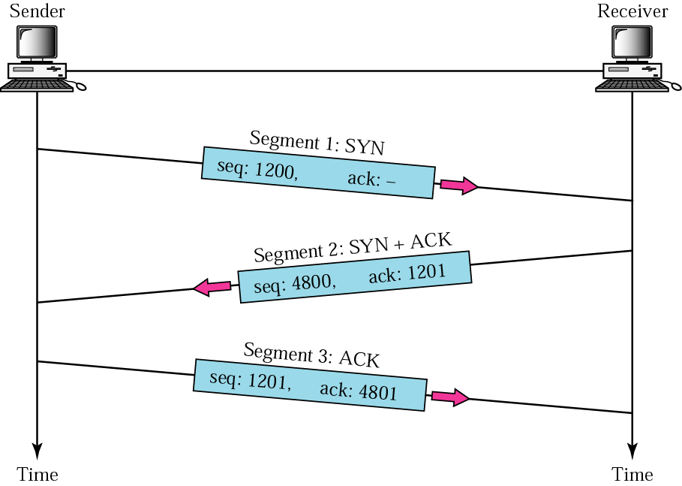
Three-way handshaking

Slide 43
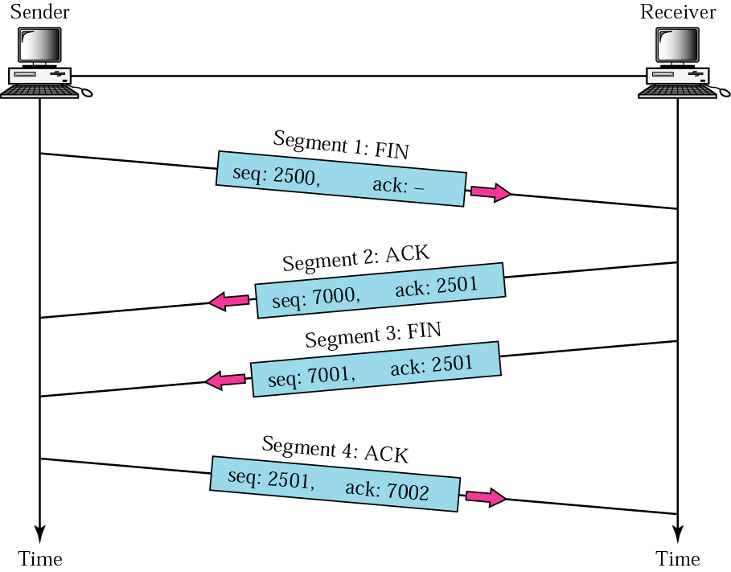
Four-way handshaking

Slide 44
STATE
TRANSITION
DIAGRAM

Slide 45
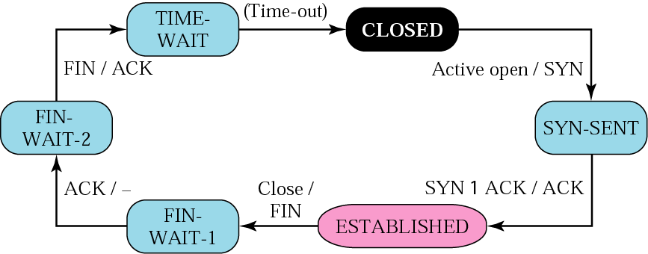
Client states

Slide 46
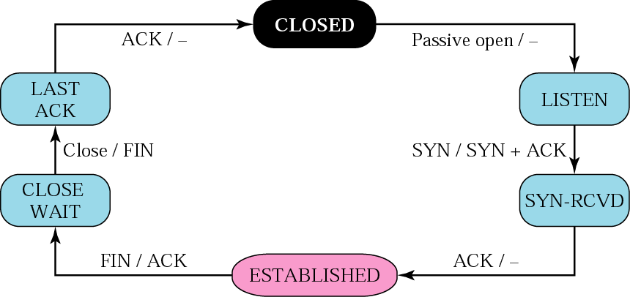
Server states

Slide 47
TCP
OPERATION

Slide 48
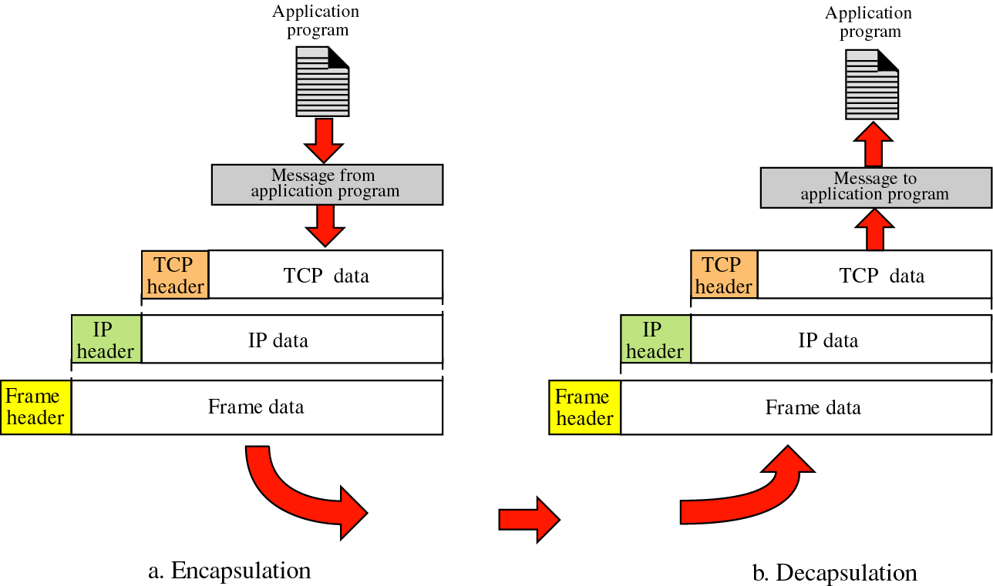
Encapsulation and decapsulation

Slide 49
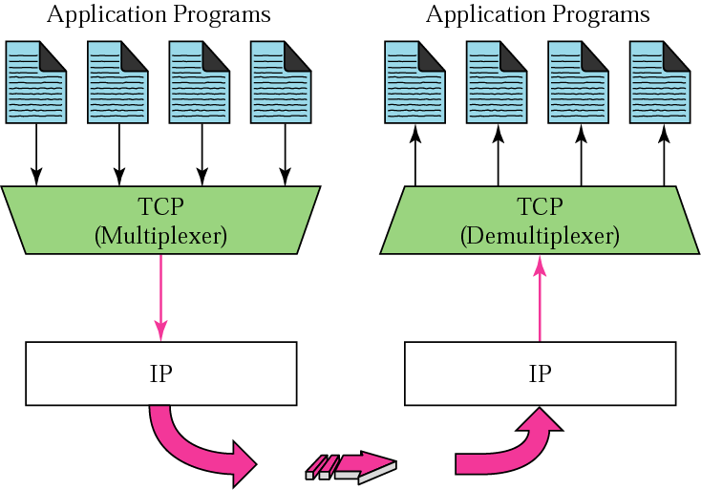
Multiplexing and demultiplexing

